Slide 1
CSC 490 Senior Capstone Presentation 3:
“MyAlmanack”
Justin Oakley, Hao Zhang, Mark Bures, Mike Resnik, Pooya Motee

Slide 2
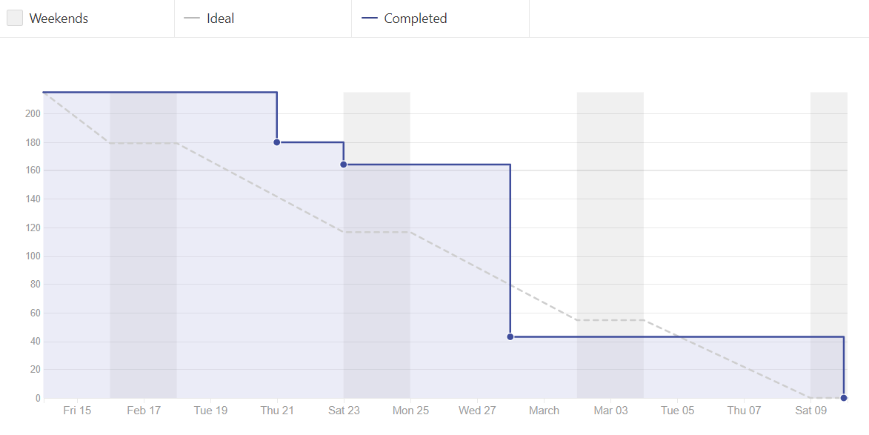
Scrum Report: Burndown Chart
Start of Individual Subsystems to Early Testing

Slide 3
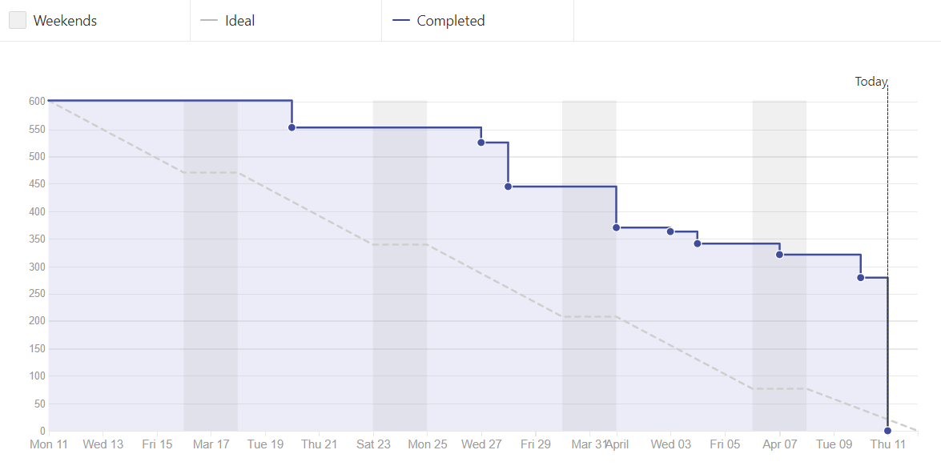
Scrum Report: Burndown Chart
Implementing and Merging Subsystems for Working Application

Slide 4
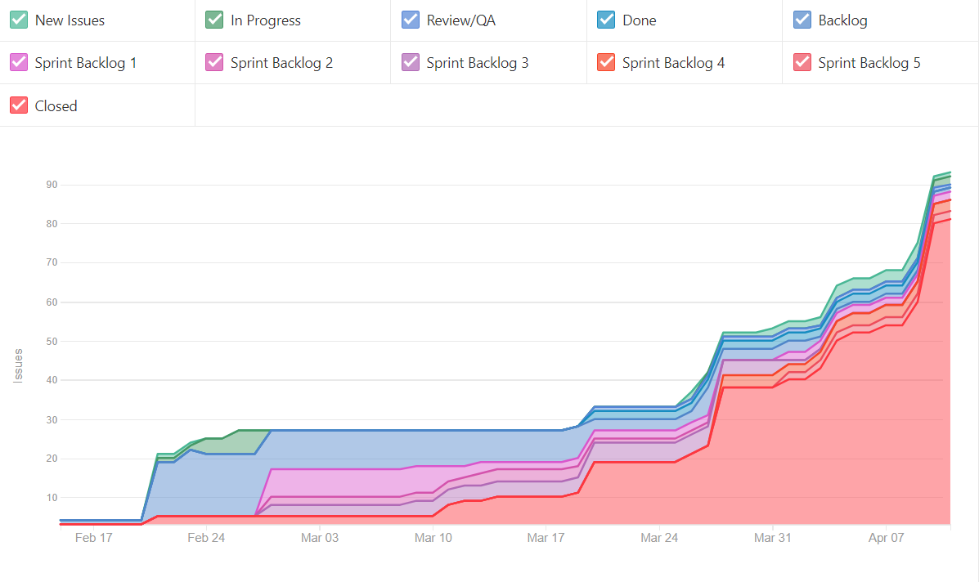
Scrum Report: Cumulative Report

Slide 5
MyAlmanack Subsystems
Authentication
Authorization
Calendar Data
Database
User Interface

Slide 6
Authentication
Current Status
The subsystem is currently considered feature-complete. Any additional changes will likely be bug fixes or optional feature additions.
Components
Web interface for logging in and out of MyAlmanack
Automatic user session management
Redirection to appropriate webpages on user session change

Slide 7

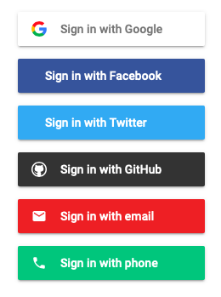
Authentication
Convenience
The subsystem makes use of Google Firebase’s authentication API and web interface.
This allows for logging in using multiple federated authentication services, providing users with a variety of authentication choices.

Slide 8
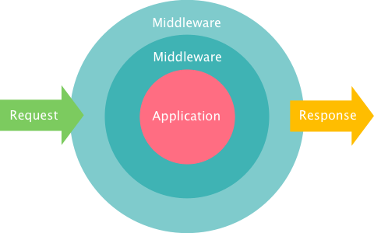
Authentication
Security
The subsystem adds a middleware to Django for monitoring user sessions.
When a user’s session becomes invalid, the middleware will automatically redirect them back to the login page without requiring manual intervention.

Slide 9

Authentication
Modularity
The subsystem is completely independent of other subsystems.
It can therefore be changed or moved to another system with minimal changes required.

Slide 10
Authentication
Future Plans
Document the code.
Add the ability to log in with Microsoft and Yahoo accounts.
Monitor for security weaknesses in the subsystem.
Keep the subsystem up-to-date with Google Firebase’s API and web interface components.

Slide 11
Authorization
Current Status
The subsystem has mostly been structured to specification, and is currently in a working state. Policies and actions are currently being written.
Components
Policy enforcement point - provides API to other subsystems
Policy decision point - evaluates policies
Policy information point - extracts information for policy evaluation
Attributes - binds subject, action, resource, and context to requests
Policies - constructs dynamically-evaluated authorization rules

Slide 12
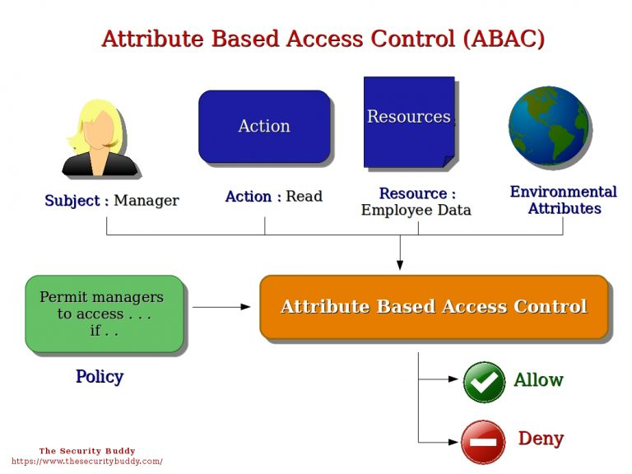
Authorization
System Structure
The subsystem uses the attribute-based access control authorization model to dynamically evaluate appropriate policies.
The subsystem has been heavily structured using object-oriented programming principles.

Slide 13
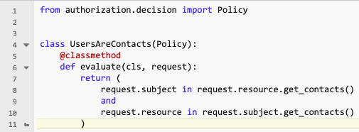
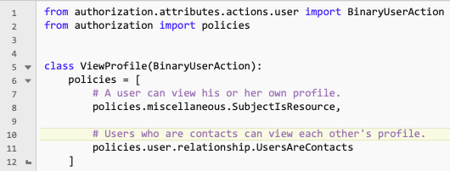
Authorization
Policies
The policies can be attached to actions where appropriate.
The policies can also be constructed using unary and binary predicates to build complex predicate logic.
These operators can be used on policy objects: ~ & | ^

Slide 14
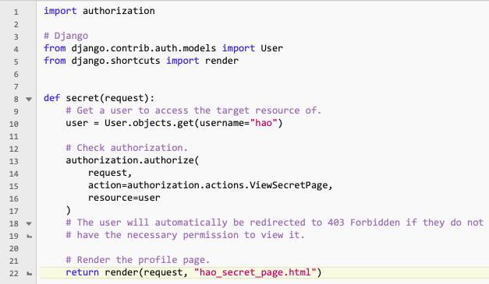
Authorization
API Usage
The goal of the subsystem was to provide easy-to-use APIs for other subsystems to use.
The API has been designed so that minimal additional code is needed in other subsystems.

Slide 15
Authorization
Remaining Goals
Finish writing database model wrappers to maintain consistent code within the subsystem and isolate unexpected external changes.
Write actions and policies that the other subsystems will need to use.
Outline API usage for the other subsystems.
Document the code.

Slide 16
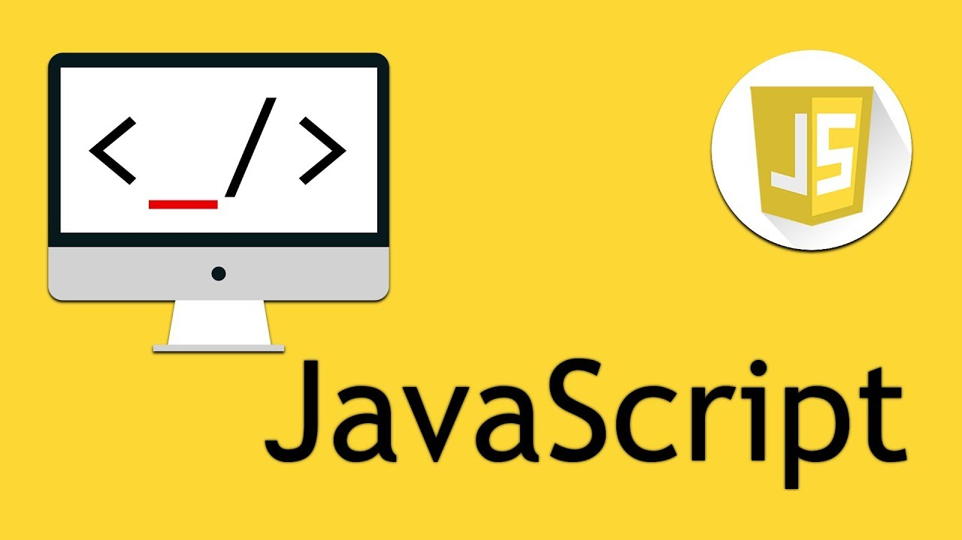
Calendar Data
Current Status
This subsystem contains functions for finding freetime from a list of current events, finding conflictions, and generating a freetime list or events list sorted by day. Switched from using Django to JavaScript.
Components
Calendar Grid Generator
Freetime calculator
Freetime per day
Events per day
Conflict

Slide 17
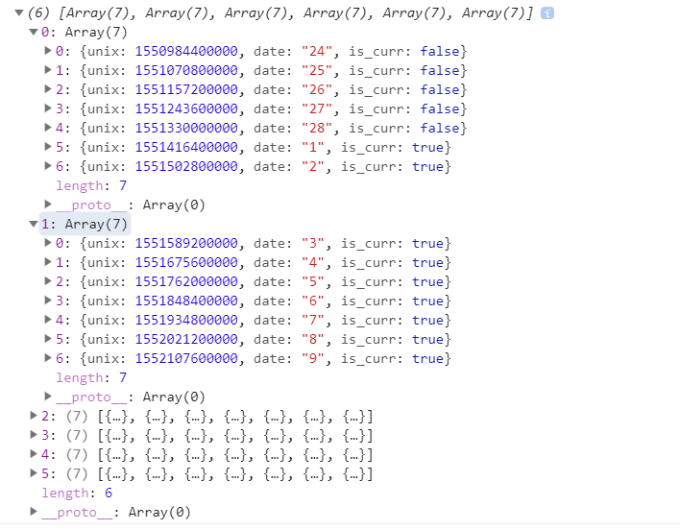
Calendar Data
Calendar Grid Generator:
genGrid(year, month){...}
Generate a 6x7 2D array of the days of the month for the monthly view of the calender with the first day of the month falling on the correct day of the week.

Slide 18
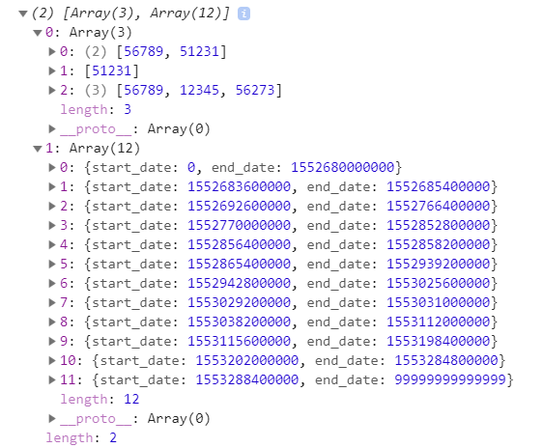
Calendar Data
Freetime calculator:
freeTime(list, threshold){...}
Takes in a list of current events and calculates the amount of free time between current events if freetime found is greater than the threshold and returns a list of freetimes.

Slide 19
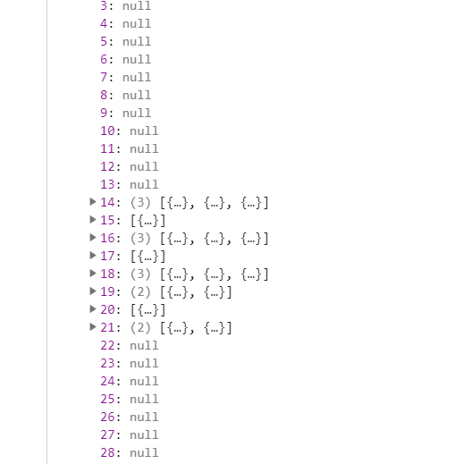
Calendar Data
Events per day:
events_per_day(list, start_date, end_date){...}
Takes in a list of current events and creates an array of size (end_date - start_date) and sorts the events by day.

Slide 20
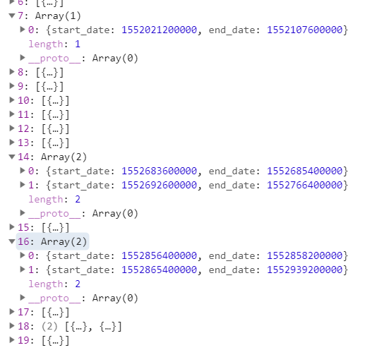
Calendar Data
Freetime per day:
freetime_per_day(list, start_date, end_date){...}
Takes in a list of freetime generated by the freeTime() function and creates an array of size (end_date - start_date) and sorts them by day.

Slide 21
Calendar Data
Conflict:
conflict (event, list){...}
Takes in a new event request and checks to see if it conflicts with any existing event in the database and returns true for there is confliction and false for no confliction.

Slide 22
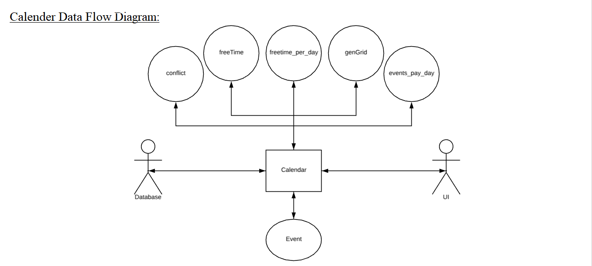
Calendar Data

Slide 23

Database
Current Status
This subsystem currently contains all basic necessary tables and functions for application functionality. As of the moment, the process of developing queries to run against the database is almost complete, with only a few simple selection-based and deletion-based inquiries that are still needed for the user-interface.
Components
PostgreSQL database containing necessary data tables and functions.
Heroku to host Postgres database and serve as a cloud platform to build and run application.
Data dictionary to provide a manual for database layout.
Django models, ORMs, and raw SQL queries for CRUD (creating, reading, updating, or deleting) of data.

Slide 24
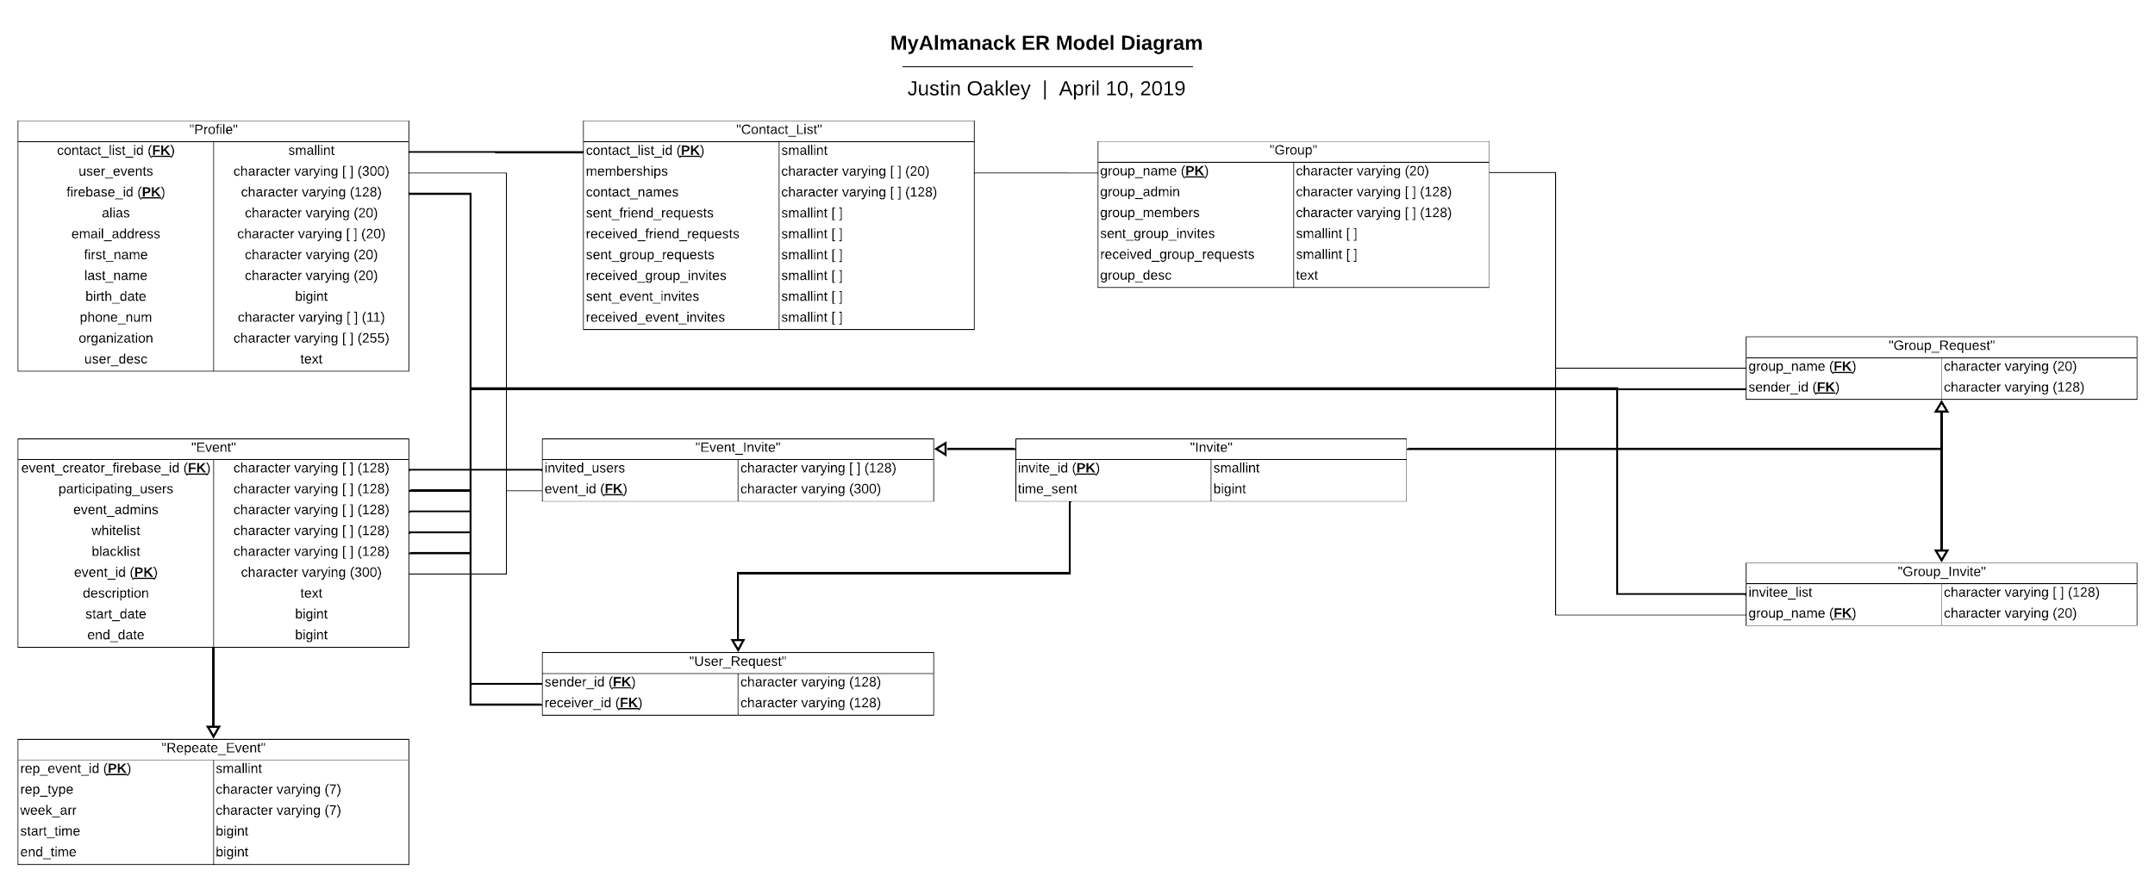
Database

Slide 25
Database
Data Summary:
Profile:
Necessary Fields: firebase_id, alias, contact_list_id, first_name, last_name, birth_date
Non-Necessary Fields: email, phone_num, organization, user_events, user_desc
Contact_List:
Necessary Fields: contact_list_id
Non-Necessary Fields: contact_names, memberships, sent_friend_requests, received_friend_requests, sent_group_requests received_group_invites, sent_event_invites, received_event_invites

Slide 26
Database
Data Summary:
Event:
Necessary Fields: event_id, event_admins, event_creator_firebase_id, start_date, end_date
Non-Necessary Fields: description, participating_users, whitelist, blacklist
Repeat_Event:
Necessary Fields: Inherits necessary traits from “Event”, rep_event_id, rep_type, week_arr, start_time, end_time
Non-Necessary Fields: Inherits non-necessary traits from “Event”

Slide 27
Database
Data Summary:
Group:
Necessary Fields: group_name, group_admin, group_members
Non-Necessary Fields: sent_group_invites, received_group_requests, group_desc
Invite:
Necessary Fields: invite_id, time_sent
Non-Necessary Fields: None
Group_Invite:
Necessary Fields: Inherits necessary traits from “Invite”, group_name
Non-Necessary Fields: invitee_list

Slide 28
Database
Data Summary:
Group_Request:
Necessary Fields: Inherits necessary traits from “Invite”, sender_id, group_name
Non-Necessary Fields: None
User_Request:
Necessary Fields: Inherits necessary traits from “Invite”, sender_id, receiver_id
Non-Necessary Fields: None
Event_Invite:
Necessary Fields: Inherits necessary traits from “Invite”, event_id
Non-Necessary Fields: Inherits non-necessary traits from “Invite”, invited_users

Slide 29
Database
Coding Approach:
Most of the database subsystem utilizes an object-oriented programming approach since it deals directly with creating, manipulating, and deleting data objects.
When writing queries for the application, there was a combination of using Django models (for simple database operations) and raw SQL (for advance database operations) since some data fields utilized PostgreSQL’s unique data types (the most used being arrays), as well as making the code readable and reliable.

Slide 30
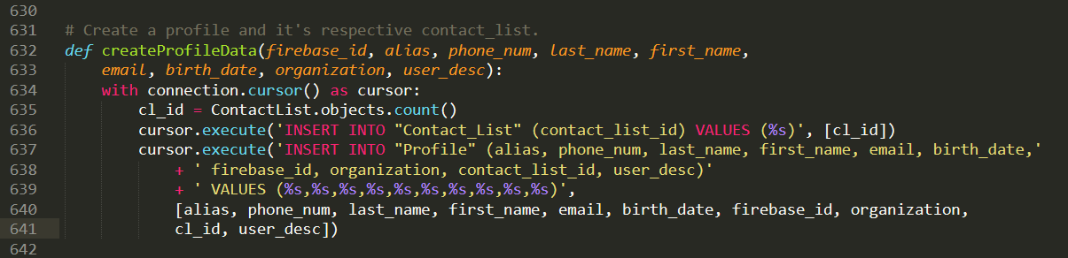
Database
Coding Example of Combining Django Data Models and Raw SQL Queries:

Slide 31
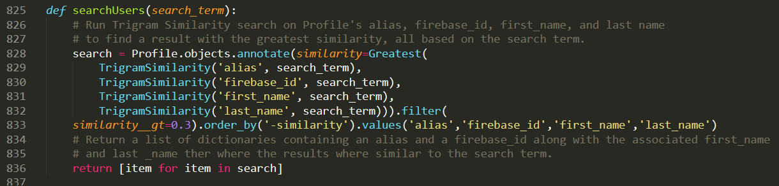
Database
Coding Example of Combining Django Data Models and Raw SQL Queries:

Slide 32


Database
Refinements:
The initial data models went through several changes involving the insertion of “Group_Request” and “Repeat_Event”, the deletion of “Admin” and “Calendar”, and editing of table fields and keys.
The major change made to the database subsystem was the change from MySQL to PostgreSQL. Postgres was inheritally compatible with Heroku and provided more functionality needed to optimize data-handling.

Slide 33
User Interface
Current Status
This subsystem contains all necessary views and elements to support rendering dummy data passed to them. The calendar has all the freetime and overlapping functionality we set out to achieve. What’s left is to connect view elements to queries and change the data passed from queries into a renderable format.
Components
Django templates in HTML which can inherit and contain other templates.
Javascript and CSS (Cascading Style Sheet) for each template.
Notes:
Mark

Slide 34

User Interface
Coding Approach
Functional Javascript / jQuery
Global-Oriented programming and function reference.
JSON Structure modelling
We reused methods for drawing the Calendar and each template had different globals which were referenced by each template.
How data is passed:
Database Query > Python Dictionary > JSON > Template > Javascript Structure
Notes:
Mike

Slide 35
User Interface - Structure
Profile View
User
Friend
Self (MyAlmanack)
Calendar Pane
Edit Profile View
Group View
Search View
Navigation Bar
Home Button
Event Invites
Search Bar
Friend Invites
Group Invites
Settings
Create Group
Edit Profile
Logout
Notes:
Mark

Slide 36
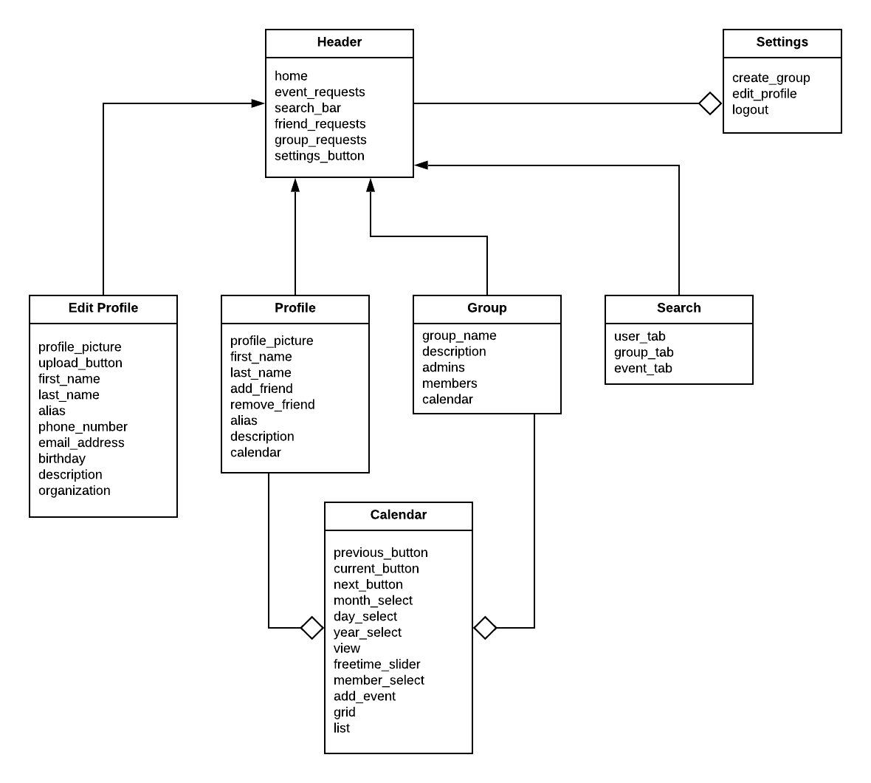
User Interface - Structure Diagram
Notes:
Mike

Slide 37
Training Plan
Authentication / Authorization :
Code and test permission authorizations
Database :
Creating several different POST requests in the UI
Calendar Data:
Make dummy data events which conflicted to test freetime.
User Interface :
Open website on different devices and changing resolution.
Speed test users who are unfamiliar with the product using the UI to see if it’s intuitive.
May use the system to schedule our next meetings.

Slide 38
Demo

